Slide 1

Access Control
Video Intercom
Introducción de Productos
Notes:
Hello everyone! Welcome to our seasonal product promotion.

Slide 2
CONTENIDO
_{Access Control}
Part.01
_{Video Intercom}
Part.02
_{Software}
Part.03
Notes:
First we will introduce access control & speed gate turnstile part.

Slide 3
01
Product Introduction
_{Access Control}
MinMoe Face Recognition Terminal
Access Control 2.0 Products
Accessory & Kit
Notes:
First part is access control .

Slide 4


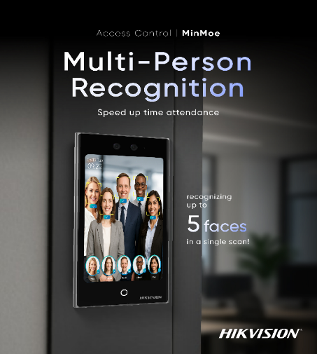
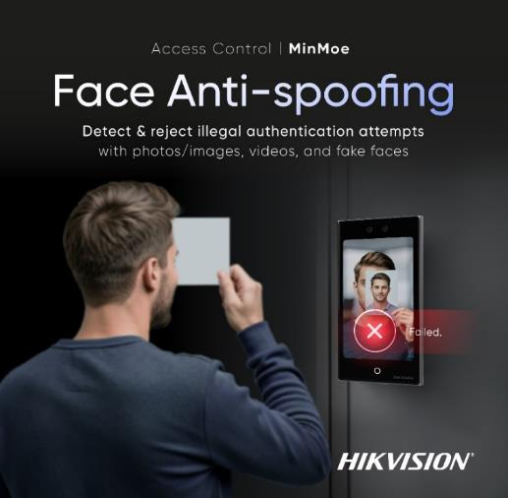
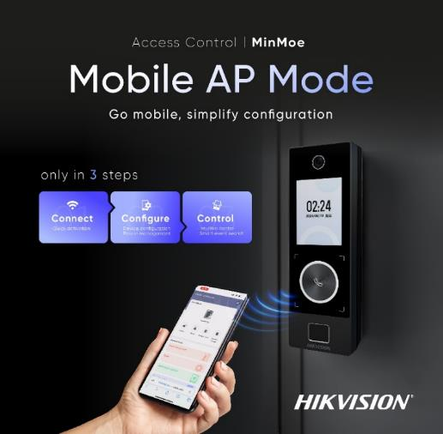
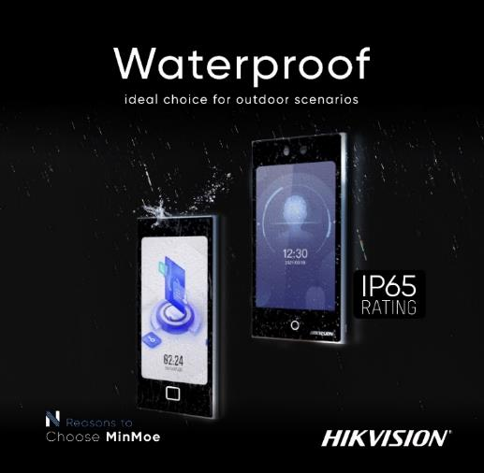
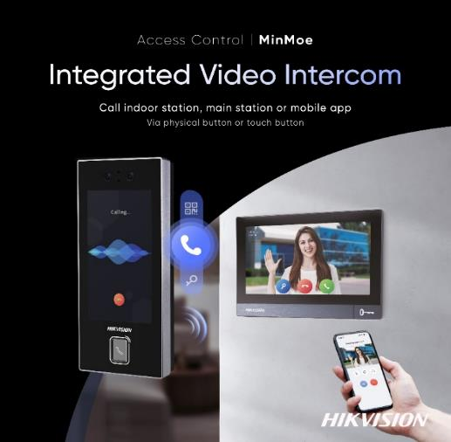
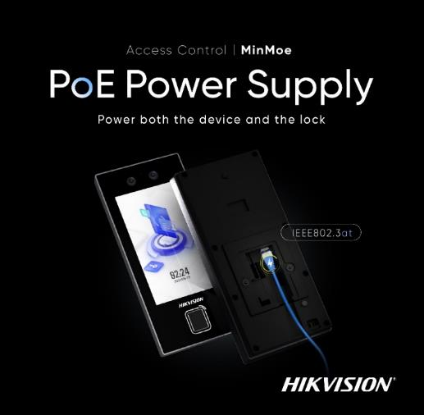
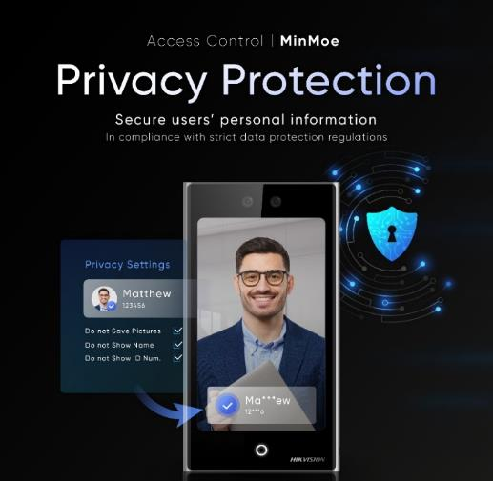
Razones para elegir
…
To be continued

Slide 5





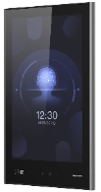







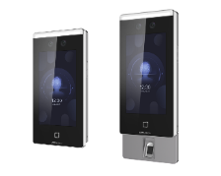










Face Recognition Terminal Family
Face Module for Barrier
DS-K5671: 50,000 faces
≥ 50,000
faces
DS-K1T981: 10,000 iris
100,000 faces
DS-K1T690: 100,000 faces
Project
Ultra Series
≥ 50,000
faces
DS-K1T681: 100,000 faces
DS-K1T680: 100,000 faces
DS-K1T672: 50,000 faces
DS-K1T673T: 100,000 faces
DS-K1T671T: 50,000 faces
Pro Series
≥ 6,000
faces
DS-K1T673: 10,000 faces
DS-K1T670: 6,000 faces
DS-K1T344: 3,000 faces
Distribution
≤ 3,000
faces
DS-K1T342: 1,500 faces
Value Series
DS-K1T343: 1,500 faces
DS-K1T323: 1,000 faces
DS-K1T321: 500 faces
DS-K1T320: 500 faces
Notes:
明眸产品家族，分为经销产品和项目产品，最主要的区别之一是人脸容量的不同，各位可以根据客户需求按需选型，具体产品特性功能会在后面展开讲解
本季度新品为明眸1T344系列产品
This page is about the face recognition terminal family.
We have many kinds of products
For the face recognition terminal family, because the different face capacity, MinMoe can be divided into distribution products and project products
For example, if you have project, and all the employee members, just like 3000 , at this time you can choose value series. And if you have more people ,you can choose pro series、ultra series. And we still have the Face recognition terminal for the Barrier or the turnstile.
DS-K1T344 series are our new products

Slide 6




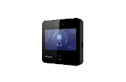


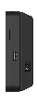






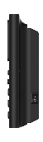


Distribution MinMoe Terminal Family
IP65
IP65
DS-K1T344
Face：3,000
Fingerprint：3,000
Outdoor Flagship
Card：3,000
Event：150,000
IP65
DS-K1T342
Face：1,500
Fingerprint：3,000
Card：3,000
Event：150,000
Distribution
DS-K1T343
Face：1,500
Fingerprint：3,000
Card：3,000
Event：150,000
Battery Version: DS-K1T343M/EFWX-B
IP65
IP65
DS-K1T323
Face：1,000
Fingerprint：3,000
Outdoor Economy
Card：3,000
Event：150,000
DS-K1T321
Face：500
Fingerprint：3,000
Card：3,000
Event：150,000
Battery Version: DS-K1T321M/EFWX-B
DS-K1T320
Face：500
Fingerprint：1,000
Card：1,000
Event：100,000
Battery Version: DS-K1T320M/EFWX-B
means on-device time attendance
Notes:
关于经销产品可以分为三个等级：
320、321为最低端入门级产品，2.4寸非触摸屏，单目识别，价格经济
343为第二个等级，4.3寸触摸屏，双目识别，自带桌面支架，适合于一些考勤场景的使用
342、341C、344为经销产品最高级，4.3寸（344为4.5寸触摸屏）触摸屏，IP65防护等级，适合于户外使用
About the distribution MinMoe face recognition terminal family, it can also seen as three levels: 320、321 are the entry-level products, non-touch screen，single lens。 343 is the mid-range product, 343 is touch screen, horizontal version, and the 342, 341C also touch screen, vertical version, support IP65, suitable for outdoor scenario

Slide 7




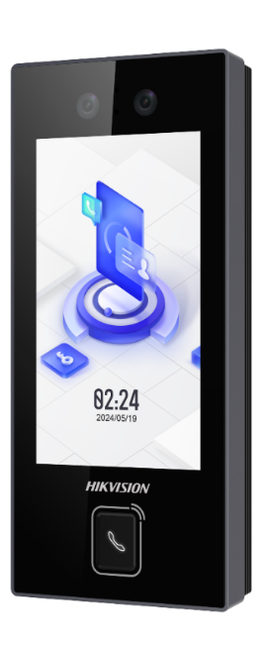









MinMoe Face Recognition Terminal
Touch-Free, Access is Easier Than Ever
Aluminum alloy & tempered glass design
Aluminum alloy
Alarm in / out for flexible linkage
Narrow bezel
Touch button / Physical button for video intercom
1.8mm Tempered glass
Easy configuration via AP mode / Web / GUI
4.5” touchscreen
Resolution:480x854
Model | DS-K1T344 Series
Face capacity | 3,000
Card type | M1/EM card
Card capacity | 3,000
Fingerprint capacity | 3,000
Event capacity | 150,000
Power supply | DC 12V & PoE
Communication | Ethernet, Wi-Fi (optional) RS-485,Wiegand USB
Installation | Wall Mounting
Language | English, Spanish (South America), Arabic, Thai, Indonesian, Russian, Vietnamese, Portuguese (Brazil), Traditional Chinese, French, Turkish
PoE
IP65
RATING
DS-K1T344 Series
Notes:
1T344系列是本季度发布的新品
1T344支持4.5寸触摸屏，窄边金属框的设计，看起来外观精美
支持alarm in、alarm out
也支持web配置管理和云管理
支持多种认证识别方式，本机带有二维码识别功能
同时也有物理按键的版本，可以通过物理按键或者触摸屏幕上的按键来呼叫对讲设备
支持IP65的防护等级，适合在室外场景使用
同时344产品全系列支持PoE
The 1T344 series is a new product released this quarter
1T344 supports 4.5 inch touch screen, narrow bezel metal frame design, looks beautiful
Alarm in and alarm out are supported
Web configuration management and cloud management are also supported
It supports multiple authentication methods, and this machine has QR code recognition function
There is also a version of the physical button, which can be called by the physical button or touch button on the screen to call the video intercom
It supports IP65 protection level and is suitable for use in outdoor scenes
At the same time, the 344 series products supports PoE

Slide 8
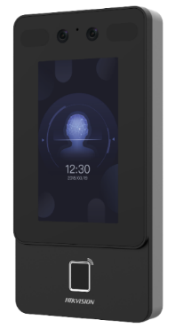
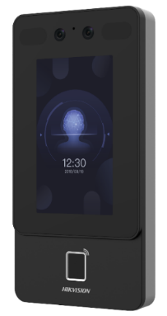

MinMoe Face Recognition Terminal
Touch-Free, Access is Easier Than Ever
Exquisite and very cost-effective
4.3-inch touch screen
Powered by deep learning algorithm
Abundant authentication modes
POE Power Supply-Directly power the device and lock(IEEE802.3at)
Upgrade
Model | DS-K1T342 Series
Face capacity | 1,500
Fingerprint capacity | 3,000
Card type | Felica,DESfire,Mifare1,EM
Card capacity | 3,000
Event capacity | 150,000
Masks detection | Support
Communication | Ethernet, Wi-Fi (optional) RS-485,Wiegand USB
Voltage input | DC 12V DC 12V~DC 24V(DS-K1T342D Series)
Protection level | IP65
Language | English, Spanish (South America), Arabic, Thai, Indonesian, Russian, Vietnamese, Portuguese (Brazil), Korean; Japanese，Traditional Chinese, French, Turkish
PoE
IP65
RATING
IP65
RATING
DS-K1T342 Series
DS-K1T342-E1 Series*
Notes:
Compared with the 343 series, the screen of this series is vertical but the screen of the 343 series is horizontal. It can be used outdoors with the IP65 rating.
And New model which supports POE has be released.
POE, or Power over Ethernet, is a technology that allows electrical power to be transmitted over standard Ethernet cables, in addition to data. POE provides a practical and efficient solution for powering devices, offering numerous benefits.
For example, it is cost-effective: POE eliminates the need for separate power cables and outlets, reducing the cost of installation and maintenance.
ease of installation, flexibility, safety, and scalability and so on.
And it is easy to install. POE also enables greater flexibility in the placement and location of devices, as they are not restricted by the availability of power outlets. This can be especially useful in areas where power sources are limited or in remote locations.
POE is also suitable for long distance power supply.
Overall, POE provides a practical and efficient solution for powering devices, offering numerous benefits in terms of cost, ease of installation, flexibility, safety, and scalability.
POE (Power over Ethernet) 是一种技术，它允许通过标准的以太网电缆传输电力和数据。这意味着设备可以通过网络电缆同时传输数据和电力，而无需使用额外的电源线。
POE的优势包括：
简化安装：POE技术可以将电源和数据传输整合到一根网线中，避免了额外的电源线路，从而简化了安装过程。
更灵活的设备布置：由于POE技术可以通过网络线路提供电力，设备的布置更加灵活，不再受限于电源插座的位置。
降低成本：POE技术可以避免在安装和维护过程中需要购买和布置额外的电源线路和插座，从而降低了成本。
提高安全性：由于POE技术可以提供短路保护和过载保护等功能，因此可以提高设备的安全性。
更容易管理：使用POE技术，设备可以通过一个中心化的管理系统进行集中管理，从而更加方便和高效。
劣势：
供电限制：POE设备的供电能力有限，通常只能提供少量的电力。如果需要为大功率设备供电，则需要使用专门的POE+或POE++设备。
总之，POE设备具有简化安装、提高灵活性、提高可靠性和降低成本等优点，但也存在供电限制和传输距离限制等劣势。在选择是否使用POE设备时，需要根据具体的应用需求和场景来进行选择。

Slide 9
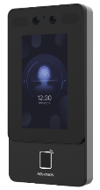

1T342 & 1T344 Series
Comparison
DS-K1T342 Series
DS-K1T344 Series
Face: 1,500; Fingerprint: 3,000;
Card: 3,000
Face: 3,000; Fingerprint: 3,000;
Card: 3,000
Capacity
Dimensions
91.3mm x 181.3mm x 24.5mm
75.7mm x 165.2mm x 25mm
Screen Size
4.3-inch touch screen
4.5-inch touch screen
Resolution
272 x 480
480 x 854
Tempered Glass
1.1mm tempered glass
1.8mm tempered glass
Appearance Design
Plastic bezel
Metal narrow bezel
Alarm in / out
N/A
Support
PoE
Support(-E1 series)
Support
AP Mode
N/A
Support
Physical Button
N/A
Support
Bluetooth
N/A
Support
QR code
N/A
Support
Notes:
下面是新品344和342、341C的区别：
Here are the differences between the new 344 and 342 and 341C:

Slide 10
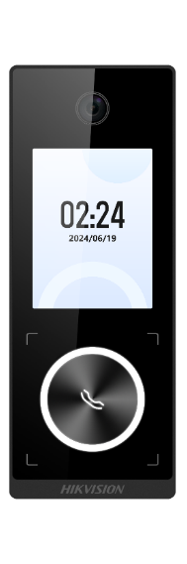
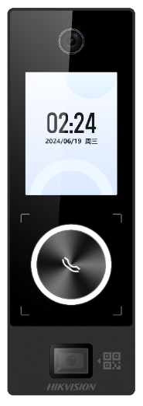
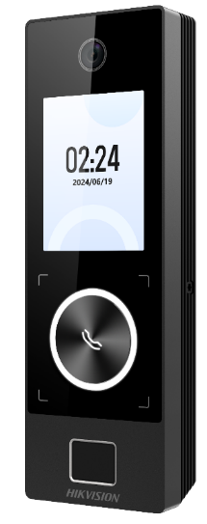
MinMoe Face Recognition Terminal
Touch-Free, Access is Easier Than Ever
Value Series
Narrow metal strip design
Video intercom via physical button
Easy configuration via PC & mobile web
Model | DS-K1T323 Series
Face capacity | 1,000
Card type | M1/EM card
Card capacity | 3,000
Fingerprint capacity | 3,000
Event capacity | 150,000
Power supply | DC 12V & PoE
Communication | Ethernet, Wi-Fi (optional) Wiegand
Installation | Wall Mounting
Language | English, Spanish (South America), Arabic, Thai, Indonesian, Russian, Vietnamese, Portuguese (Brazil), Turkish, French
PoE
IP65
RATING
DS-K1T323 Series

Slide 11


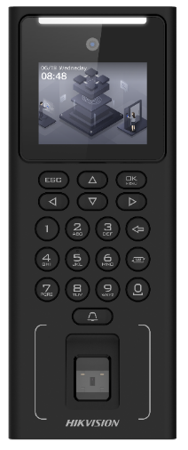
MinMoe Face Recognition Terminal
Touch-Free, Access is Easier Than Ever
Powered by Deep Learning Algorithm
Value Series
supports face anti-spoofing and privacy protection
Multiple Authentication Methods
including Face, Fingerprint, Card, PIN code
Easy Device Configuration
supports web configuration via PC & mobile phone
supports AP Mode
Optional Backup Battery
increased system reliability during blackouts
Model | DS-K1T321 Series
Operation system | Linux
Face capacity | 500
Card type | M1、EM
Card capacity | 3,000
Fingerprint capacity | 3,000 (optional)
Event capacity | 150,000
Power supply | DC 12V
Communication | TCP/IP, Wi-Fi RS485 USB
Installation | Wall Mounting
Language | English, Spanish (South America), Arabic, Thai, Indonesian, Russian, Vietnamese, Portuguese (Brazil), Korean; Japanese
DS-K1T321 Series
Notes:
DS-K1T321 Series is our important product of Value Series. It supports Optional backup battery version.
Its appearance is just like 320. This series is vertical but the 320 series is horizontal version
1t321 is also support 2.4-inch non touch screen. With physical button too, so it can also use the AP mode function to operate. But it support 500 face capacity.
And RS485 interface is another highlight. With its 485 interface, it has better extensibility. You can use it to connect with other devices which supports RS485, such as Secure module or readers.

Slide 12


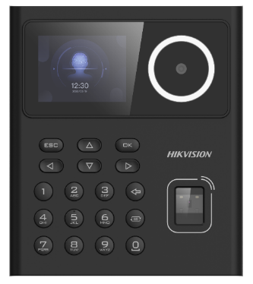
MinMoe Face Recognition Terminal
Touch-Free, Access is Easier Than Ever
Deep Learning Algorithm
supports face anti-spoofing and privacy protection
Value Series
Multiple Authentication Methods
including Faces, Fingerprint, Cards, PIN code
Easy Device Configuration
supports web configuration via PC & mobile phone
supports AP Mode
Optional Backup Battery
increased system reliability during blackouts
Model | DS-K1T320 Series
Operation system | Linux
Face capacity | 500
Card type | M1、EM
Card capacity | 1,000
Fingerprint capacity | 1,000(optional)
Event capacity | 100,000
Power supply | DC 12V
Communication | TCP/IP, Wi-Fi USB
Installation | Wall Mounting/Desktop (available bracket：DS-KAB320-D1)
Language | English, Spanish (South America), Arabic, Thai, Indonesian, Russian, Vietnamese, Portuguese (Brazil), Korean; Japanese
DS-K1T320 Series
Notes:
About MinMoe 1T320, support 2.4-inch non touch screen. With physical button,. Because of the physical button, it’s hard to operate, so we can use the AP mode function via mobile phone to operate.
In the price of it, the price of 320 is close to the price of the fingerprint terminal, and increased face recognition，support 500 face capacity
in fact, 1T320 compared to the 343 , 343 is a touch screen, 320 is a non-touch screen, 343 and other face recognition terminal has a speaker, 320 only a buzzer, and 320 does not have peripheral interfaces

Slide 13













Project MinMoe Terminal Family
DS-K1T981: 10,000 iris
100,000 faces
Support iris recognition
Ultra Series
DS-K1T690: 100,000 faces
Android system
15.6-inch touch screen
15.6-inch
DS-K1T681: 100,000 faces
Android system
Support flexible modular
Project
DS-K1T680: 100,000 faces
Support 4G /POE
DS-K1T673T: 100,000 faces
Support flexible modular
Support multi-person authentication
DS-K1T673: 10,000 faces
Pro Series
Support flexible modular
Support multi-person authentication
DS-K1T670: 6,000 faces
DS-K1T642: 6,000 faces
4.3-inch touch screen
4.3-inch
Notes:
Next I will introduce the project MinMoe face recognition terminal, about the terminal family,
The key features of each terminal are written on the right
We can see that the 670/673 support flexible module and multiple person authentication. The 681/690 support android system. The 981 supports iris recognition.

Slide 14
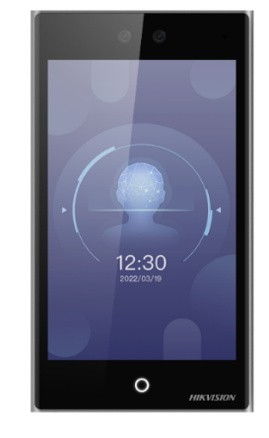

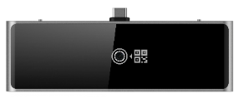
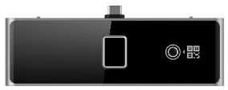
MinMoe Face Recognition Terminal
Touch-Free, Access is Easier Than Ever
Ultra Series
Android 11 System
for open platform 3rd-party integration
Accurate authorization
of single or up to 5 persons simultaneously
Flexible modular design
meets a diverse set of needs
Customizable images & videos
for digital advertisements
Model | DS-K1T681 Series
Operation system | Android 11
Face capacity | 100,000
Card type | DESFire、Felica、M1
Card capacity | 500,000
Fingerprint capacity | 10,000
Event capacity | 500,000
Power supply | DC 12V~24V
Communication | Ethernet, Wi-Fi (optional) RS-485,Wiegand Bluetooth , USB
Protection level | IP65
Language | English, Spanish (South America), Arabic, Thai, Indonesian, Russian, Vietnamese, Portuguese (Brazil), Korean, Japanese, Traditional Chinese
IP65
RATING
DS-K1T681 Series
*Modules with Type C interface
Notes:
This product is Android system, which means that the 3rd-party integration is more friendly and open.
It can support 100,000 face capacity. The card type can support DESFire, Felica, Mifare card. the device’s protection level is IP65.
It can support single person or multi-person authentication, and up to five people can be supported for authentication at the same time.
You can choose to the different external modules according to your requirements. There are QR code module, fingerprint module, also have QR code and fingerprint module.
The device also support bluetooth
But as we know， card is easy to lose, When employees loss their cards, they cannot enter the office gate.
For the fingerprint , many people touch the same place to authentication, it is unhealthy.
And After the experience of the covid-19, more and more people are inclined to touchless, which is not only face recognition, but also the operation on the mobile phone. Because now everyone will carry the smart phone with them when they go out, we can input the card into the mobile phone and open the door through Bluetooth, and this function can be set on the HCAC

Slide 15

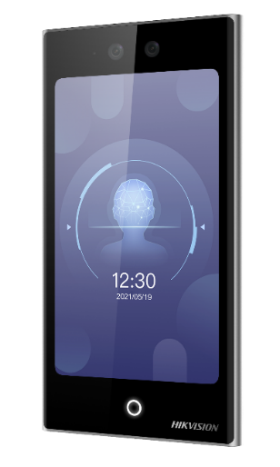





MinMoe - DS-K1T673/T Series
Touch-Free, Access is Easier Than Ever
Two-door control（with wireless module）
Gate 1: via face recognition
Gate 2: via keyfob
One-press intercom calling
via the physical button（with wireless module）
Multi-person authentication
Accurate recognition of single or up to 5 persons
Flexible modular design
Combination of modules including fingerprint, Bluetooth, and QR code
Customizable advertisement
Up to 8 customizable pictures or headlines for digital advertisement
High-capacity
DS-K1T673 Series / DS-K1T673T Series
10,000 face, 50,000 card (for DS-K1T673 Series),
100,000 face, 500,000 card (for DS-K1T673T Series),
10,000 fingerprint (with fingerprint module)
New Version- V4.38.0
*Modules with Type C interface
Standard SIP(ASTERISK、3CX、ELASTIX、miniSipServer、Brekeke、OpenSIPs、Kamailio )
Support duplicated face picture check
Call mobile APP（HC-T mode）
Timeout reminder of open the door
Authentication is successful, but the door is closed(only T&A)
Support dynamic QR code V2.0
Support custom Wiegand
Bluetooth module | DS-KAB673-B
Bluetooth + QR code module | DS-KAB673-BQR
Fingerprint + Bluetooth module | DS-KAB673-FB
Fingerprint + Bluetooth + QR code module | DS-KAB673-FBQR
433MHz + QR code module | DS-KAB673-WBQR
868MHz + QR code module | DS-KAB673-WEQR
Notes:
The 673 and 673T series are our hot selling product for projects.
The 673 series support 7 inch touch screen and on-screen card reader. It support multiple authentication methods: face/card/fingerprint/PIN code/bluetooth/QR code and NFC.
the 673 series supports 10,000 faces and the 673T series supports 100,000 faces. These two series support multi-person authentication up to 5 people for high efficient attendance and advertisement function with up to 8 pictures
with a type-c interface for different external modules , you can choose modules according to your requirements.
The latest version of 673 supports face checking, Wiegand customization, and connection to 1109 card readers
673单独特性写一页

Slide 16






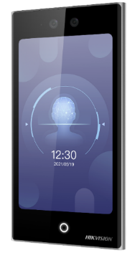
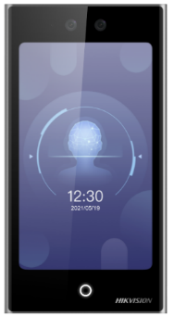
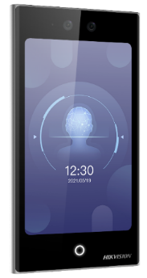
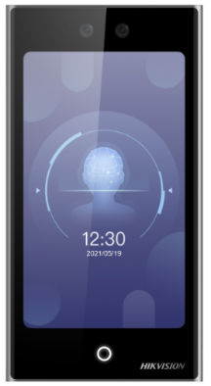









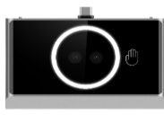
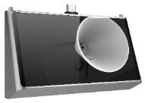




MinMoe - DS-K1T673/T Series
Touch-Free, Access is Easier Than Ever
1T673 series’ Functions
PoE Version
Alcohol detection
Palm print & palm vein recognition
Release time:
August 2025
Upgrade
Dual-frequency card identification
(EM&M1&DESFire)
3/4G
PoE
*Note: All the functions shown in the left will have the PoE version.
Two-door control
Video intercom
QR code recognition
Bluetooth recognition
Notes:
34G保留
PoE八月样机

Slide 17
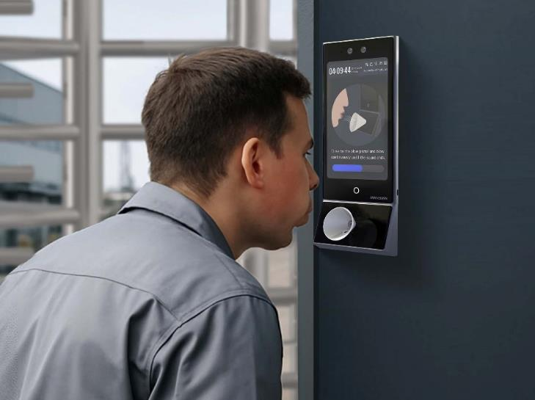





MinMoe - DS-K1T673/T Series
-Alcohol Detection + Identity Verification
Diseño de apariencia sobresaliente
Pantalla táctil de 7 pulgadas con lector de tarjetas en pantalla
Face Recognition Terminal
DS-K1T673/673T Series
Abundantes modos de autenticación
Face, card (Felica, DESfire, Mifare 1), pin code
fingerprint, Bluetooth, and QR code (via module)
Alcohol detection module
DS-KAB673-A
Módulo de detección de alcohol*note1 (con interfaz tipo C)
Sensor electroquímico de alcohol
Non-contact
0.5 ~ 1.5s tiempo de soplado (configurable)
0~4s Tiempo de análisis de alcohol
0.000 ~ 2.000mg/L Rango de medición (0.001mg/L precisión)
Drinking: 0~0.1mg/L ±0.03mg/L; Drunken: 0.1~0.4mg/L ±0.06mg/L *note3
2 añosVida útil del sensor
Aplicación en interiores*note4
Módulo de detección de alcohol | DS-KAB673-A
Boquilla *note2 (Reemplazable y sin contacto requerido) | DS-K7MX-A0
Note1: El módulo de detección de alcohol debe pedirse por separado, cada módulo de detección de alcohol incluye una boquilla de 5 piezas de forma predeterminada
Note2: La boquilla se puede pedir por separado, Model: DS-K7MX-A0, Sap Code: 305701312, 40pcs boquilla incluida por defecto
Note3: El umbral del estado de consumo de alcohol o estado de embriaguez puede ser autodefinido
Note4: Módulo de detección de alcohol solo para uso en interiores
Alta capacidad
10,000 faces, 50,000 cards (for DS-K1T673 Series),
100,000 faces, 500,000 cards (for DS-K1T673T Series)
10,000 fingerprints (via fingerprint module)

Slide 18

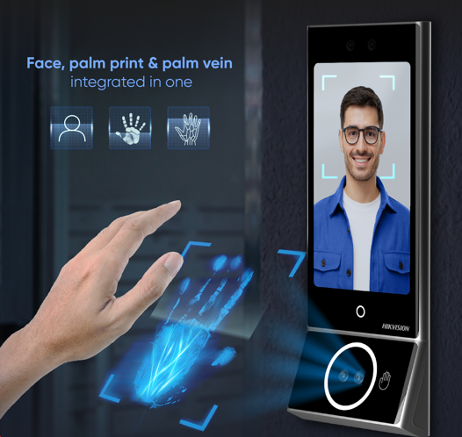




MinMoe - DS-K1T673/T Series
-Palm print & Palm vein recognition
Palm print & palm vein recognition
Las huellas y venas de la palma se reconocen principalmente por sus características de textura. Para el reconocimiento de huellas y venas, se requiere luz visible, y la vena de la palma debe complementarse con luz infrarroja, que ofrece alta resistencia a la falsificación y alta precisión.
DS-K1T673/673T Series
Algoritmos de aprendizaje profundo
Alta precisión de reconocimiento Reconocimiento rápido
Palm print & palm vein recognition module
DS-KAB673-P
Alta seguridad
La estructura de la huella de la palma y la vena de la palma es única Reconocimiento dual de huellas palmares y venas de la palma
Adapte múltiples entornos
DS-K1T673 Series / DS-K1T673T Series
No se ve afectado por el entorno, la expresión y otros factores
Support 10,000 palm prints/palm veins
Protección de la privacidad
Escanee la palma de la mano, evite el riesgo de fuga de información personal
Notes:
掌纹掌静脉识本质上是通过掌纹和掌静脉的纹路特征进行识别。其中掌纹需要采用可见光，掌静脉需要采用红外灯补光，具有高度防伪、高度准确的特点

Slide 19
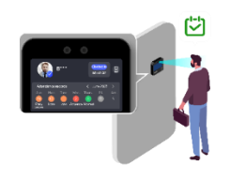
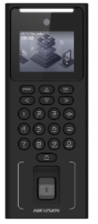
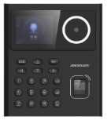
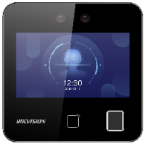

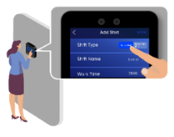
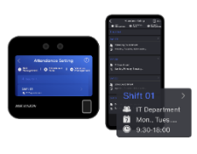

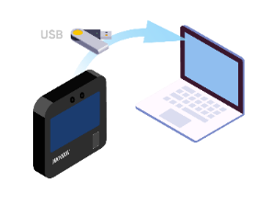
Solution: On-device Time Attendance
Suitable for time attendance in small scenarios
Supported Models
Smart Time Attendance Management
Admite múltiples métodos de asistencia: reconocimiento facial / huellas dactilares / tarjetas, etc. Mostrar el registro de asistencia durante la verificación Admite dos tipos de visualización de resultados de asistencia
En el dispositivo Ajuste de turno normal o turno flexible
Note：solo la serie 1T343 admite una configuración de cambio flexible
DS-K1T320
DS-K1T321
DS-K1T343
Configuración de reglas de presencia
En el dispositivo o en la web móvil/PC
Key Features
Función de asistencia de tiempo local para MinMoe. Realice funciones de acceso y asistencia en un solo dispositivo. Satisfacer las necesidades de las pequeñas y medianas empresas.
Tipo de informe de asistencia: hay 5 tipos de informes de asistencia Formato del informe de asistencia: excel
No es necesario configurar la red. Todas las gestiones se pueden completar en el dispositivo.
Exportación de informes de asistencia
desde dispositivos a través de USB/web móvil/web de PC directamente
Notes:
单机考勤，无需学习软件，简单易用
Here is our new function for MinMoe. Local Time Attendance.
Realize access control and time attendance functions with one device. That means we don’t need to configure network.
This function can meet the needs of small and medium sized businesses
No need to configure network.
All management can be finished locally.
Reports can be exported via USB.

Slide 20

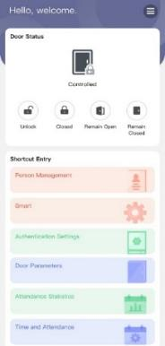
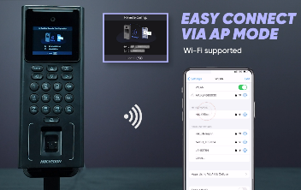
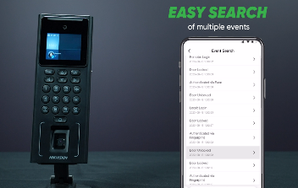
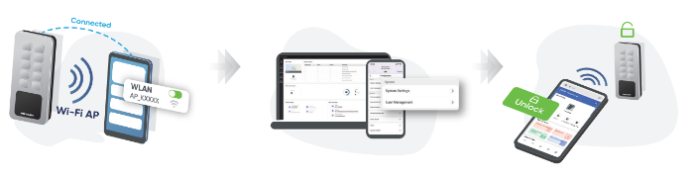
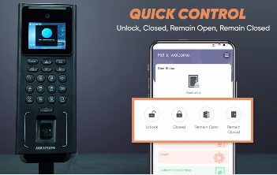
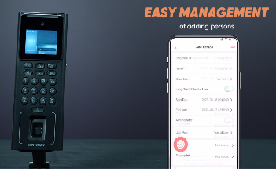



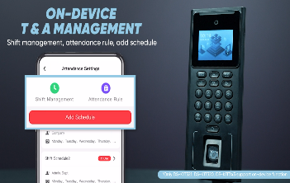
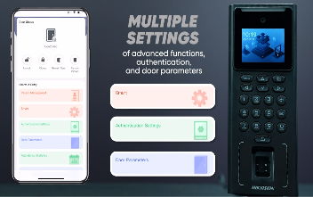





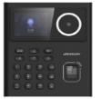
Solution: Mobile Web Configuration
Facilitar el funcionamiento y la configuración del dispositivo
Key Functions
Admite la activación y configuración en la web móvil.
Admite registros de eventos de búsqueda en la web móvil.
Supported Models
Admite el control remoto de puertas en la web móvil.
Apoyar la gestión del personal en la web móvil.
1T344
1T341C
1T342
1T343
1T323
1T320
1T321
1T502
1T805
Admite la gestión de asistencia en el dispositivo en la web móvil. (solo 1T320, 1T321 y 1T343)
Admite múltiples configuraciones en la web móvil.
Notes:
移动web，手机搞定所有配置和日常管理！
About mobile web, mobile web is easy to operate. We can support activation and configuration、search the event records、remote the door control、on-device time attendance on the mobile web.

Slide 21
Access Control 2.0 Products
Notes:
Next is controllers.

Slide 22
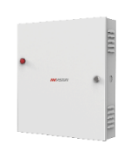









Access Controller Family
Product range | Value series | Pro series | Ultra series
Product Image
DS-K2801/2/4
DS-K2601/2/4T
26 series main board
DS-K2621/2/4X
262X series main board
DS-K2601/2/4-G
Main controller DS-K2700X Access module DS-K2M002X
Product Model
DS-K2811/2/4
Door Control
1/2/4
1/2/4
1/2/4
1/2/4
1/2/4
MAX.128(with 62 access modules)
User Capacity
N/A
N/A
100,000
100,000
N/A
100,000
Card Capacity
10,000
10,000
100,000
100,000
100,000
200,000
Event Capacity
50,000
50,000
300,000
300,000
300,000
600,000
Backup Battery
N/A
Support
Support
Support
Support
Support
Advanced Access Control
Support
Support
(multiple authentication/interlocking
/anti-passpack/first card)
N/A
Support
Support
Support
POE
N/A
N/A
N/A
N/A
N/A
Support
Web Configuration
N/A
N/A
N/A
Support
N/A
Support
Connect the Access Module
N/A
N/A
N/A
N/A
N/A
Support
UL294 Certification
N/A
N/A
N/A
N/A
Support
N/A
Notes:
The following is the controller family, they are 28 series 、 26 series 、27 series and new 262x series

Slide 23








Access Controller Family
Value Series
Pro Series
Ultra Series
upgrade
DS-K2700X series
DS-K2M002X
DS-K260X series
DS-K262X series
Doors Control：MAX.128(with 62 access modules)
User：100,000
Card：200,000
Event Storage: 600,000
Support backup battery
Support advanced access control(multiple authentication/interlocking/anti-passback/first card)
Web configuration
Support PoE (optional)
Support LED indicator display
Support connect the access module
DS-K281X series
Doors Control: 1/2/4
User: 100,000
Card: 100,000
Event: 300,000
Support backup battery
Support advanced access control(multiple authentication/interlocking/anti-passback/first card)
Doors Control: 1/2/4
User: 100,000
Card: 100,000
Event: 300,000
Support backup battery
Support advanced access control(multiple authentication/interlocking/anti-passback/first card)
Web configuration
HC management
Doors Control：1/2/4
Card：10,000
Event: 50,000
Support backup battery
Support advanced access control(multiple authentication/interlocking/anti-passback/first card)

Slide 24










I/O Expansion Module – DS-K2M0012X
Key Features
RS-485
Multicore cable
Access Controller
I/O Expansion Module
DS-K2M0012X
Input: 8
…
Magnetic Contact
Magnetic Contact
Detector
Sounder
Output: 4
(input)
(output)
LED indicator
Note: The 270X series access controller supports access to up to 26 pcs DS-K2M0012X
The 262X series access controller supports access to up to 16 pcs DS-K2M0012X

Slide 25








Access Control Terminal Family
DS-K1T502 Series
DS-K1T510 Series
DS-K1T807 Series
Access control & Video & Video intercom
Card：100,000
Fingerprint：10,000
AP mode
Web configuration( PC & Mobile)
HC management
IP65，IK09
DS-K1T805 Series
Access control & Video & Video intercom
Face:：1,000(It’s off by default)
Card：3,000
AP mode
Web configuration( PC & Mobile)
IP65
PoE
Access control
2.4-inch LCD screen
Card：5,000
Fingerprint：5,000
AP mode
Web configuration( Mobile)
IP65
PoE
DS-K1T804 Series
DS-K1T808 Series
Access control
Card：10,000
Fingerprint：3,000
AP mode
Web configuration( PC & Mobile)
HC management
IP65，IK08
DS-K1T809 Series
Access control
2.4-inch LCD screen
Card：3,000
Fingerprint：3,000
Access control
2.4-inch LCD screen
Card：3,000
Fingerprint：3,000
AP mode
Web configuration( PC & Mobile)
Access control
User：1,000
Card：1,000/5,000
AP mode
Web configuration( Mobile)
IP65
Notes:
今年我们一体机产品推出了海量的新品，如视频门禁一体机的510系列，跟502相比最大提升是支持了标准POE；推出了室外应用的指纹一体机807；爆款804指纹一体机的升级款平替款808一体机；低端金属一体机809等等

Slide 26










Access Control Terminal
Key Features
Slim Design
Suitable for installation in space limited area
Multiple Authentication Methods
Keypad
Card
PIN code
Metal appearance
No Ethernet port
IP65
Card swipe area
Mobile web configuration(1T809E/MWX support)
AP
Supports AP mode(1T809E/MWX support)
DS-K1T809 Series
1,000*/
5,000**
100,000
Cards
Events
*Note：1T809E/MX support
**Note：1T809E/MWX support(Wi-Fi model)
Notes:
今年我们的金属一体机如805、502系列又一波明显的出货，年度出货量有望突破4W台，成为传统门禁一体机的一个新的增长点，我们在走访市场的时候，发现在主要的国家都能看到大量的金属室外一体机的场景，但是价格很敏感，基于此我们开发了低端金属一体机809系列，同时将手机web配置，AP mode等差异化特性置入这一款产品中，希望在金属一体机系列类打造新爆款

Slide 27







Access Control Terminal
Key Features
Multiple Authentication Methods
(It’s off by default)
All in one
PoE
Access Control & Video & Video Intercom
PC / Mobile web configuration
IP65
RATING
AP
Supports AP mode
DS-K1T510 Series
1,000
3,000
1,000
Users
Cards
Faces(It’s off by default)
Notes:
跟502相比，最大的提升是支持标准POE，同时窄条的设计可以适配多种场景，当然从外观看这个亚克力面板的 没有防暴特性

Slide 28





Access Control Terminal
Key Features
Multiple Authentication Methods
2.4-inch non-touch screen
PoE
Mobile web configuration
IP65
RATING
AP
Supports AP mode
DS-K1T807 Series
5,000
5,000
150,000
Fingerprints
Cards
Events
Notes:
在指纹一体机的序列内爆款产品是804一体机，年度出过超过6W台，我们在804的基础上拓展了室外的应用，同时支持如AP mode、web配置、标准POE等新特性，希望打造下一个指纹一体机的爆款产品

Slide 29





Metal Access Control Terminal
Unified Security with Robust Protection
Robust metal material
AP mode for connection*
Web configuration*
*Note: 1T809 series models without “W” do not support these two features.
1T502 series
1T805 series
1T809 series

Slide 30



















Mobile Access Solution
Tap into smart access
Bluetooth
Wave hand
Automatic
Manual
Dynamic QR codes
QR code
Refresh: Manually / Automatic
NFC

Slide 31




















Fingerprint Terminal & Card Terminal Product Comparison
Fingerprint Terminal
Card Terminal
Meatal
Access Control Terminal
Model | DS-K1T201A Series | DS-K1T808-B Series | DS-K1T8005-B Series | DS-K1T807 Series | DS-K1T804A Series | DS-K1A802A Series | DS-K1T8003 Series | DS-K1A8503 Series |  | DS-K1T510 Series | DS-K1T105 Series | DS-K1T801 Series | DS-K1T802 Series |  | DS-K1T502 Series | DS-K1T805 Series | DS-K1T809 Series
Image
Fingerprint capacity | 5,000 | 3,000 | 3,000 | 5,000 | 3,000 | 3,000 | 1,000 | 1,000 |  | / | N/A | N/A | N/A |  | 10,000 (optional) | 3,000 (optional) | /
Card Capacity | 100,000 | 3,000 | 3,000 | 5,000 | 3,000 | 3,000 | 1,000 | 1,000 |  | 3,000 | 100,000 | 3,000 | 3,000 |  | 100,000 | 10,000 | 1,000/3,000
Card Type | EM/M1 | EM/M1 | EM/M1 | EM/M1 | EM/M1 | EM/M1 | EM/M1 | EM/M1 |  | EM/M1 | EM/M1 | EM/M1 | EM/M1 |  | M1/ DESfire/ Felica | EM/M1 | EM/M1
Wi-Fi |  |  |  |  |  |  | N/A | N/A |  |  |  | N/A | N/A |  |  |  | Optional
LCD Screen | 2.8-inch LCD screen | 2.4-inch LCD screen | 2.4-inch LCD screen | 2.4-inch LCD screen | 2.4-inch LCD screen | 2.4-inch LCD screen | 2.4-inch LCD screen | 2.4-inch LCD screen |  | N/A | 2.8-inch LCD screen | N/A | 2.4-inch LCD screen |  | N/A | N/A | N/A
Backup Battery Support | N/A |  |  | N/A | N/A |  | N/A |  |  | N/A | N/A | N/A | N/A |  | N/A | N/A | N/A
Protection Level | N/A | N/A | N/A | IP65 | N/A | N/A | N/A | N/A |  | IP65 | N/A | N/A | N/A |  | IP65 IK09 | IP65 IK08 | IP65
Communication Mode | TCP / IP, RS-485, Wiegand, ISUP, ISAPI | TCP / IP, Wi-Fi, RS-485, Wiegand, ISUP, ISAPI | TCP / IP, Wi-Fi, Wiegand, ISUP, ISAP | TCP / IP, Wi-Fi, RS-485, Wiegand, ISUP, ISAPI | TCP / IP, Wi-Fi, RS-485, Wiegand, ISUP, ISAPI | TCP / IP, ISUP, ISAPI | TCP / IP, ISUP, ISAPI | TCP / IP, ISUP , ISAPI |  | TCP / IP, RS-485, Wiegand, Bluetooth, ISUP, ISAPI | TCP / IP, RS-485, Wiegand, ISUP , ISAPI | N/A | TCP/IP |  | TCP / IP, RS-485, Wiegand, Bluetooth, ISUP, ISAPI | TCP / IP, RS-485, Wiegand, Bluetooth, ISUP, ISAPI | Wiegand
Ultra Series
Pro Series
Value Series
Pro Series
Value Series
Notes:
本季度新品为指纹机808和8005，且两款新设备均支持带备用电池版本
Here is a table of Fingerprint Terminal & Card Terminal Product Comparison
New products in this quarter are the 808 and 8005, and both new devices support versions with battery backup

Slide 32
Accessory & Kit
Notes:
Next is controllers.

Slide 33




















Reader & Accessory Product Comparison
Reader
Button
Lock
Card
Issuer
DS-K1109 Series
DS-K7P01
DS-K4H250S
DS-K7M101-E0
DS-K1F600U-D6E-F
Fingerprint +PIN code +QR code DESFire/Felica/M1/EM
RS-485, Wiegand 26/34
Support Bluetooth Module
Wall mounting
Aluminum alloy panel
Metal & Physical button
500K times age
Single-door Magnetic Lock
supports static linear thrust of 280kg
EM card
Frequency: 125KHz
Face & fingerprint & card issuer
Support offline enrollment, 2000 faces, 20000 cards, 20000 fingerprint
Fashionable appearance
USB/Wi-Fi
DS-K7P04A
DS-K4H250-LZ/U
FM11RF08-M1
DS-K1104 Series
Power Supply
Stainless steel
Touchless exit button
LED indicator
LZ/U-Bracket of Magnetic Lock, for DS-K4H250S
DS-K7M-AW50
M1 card
Frequency: 13.56vMHz
M1, PC & Zinc-Alloy, IP65, IK10,
Gangbox mounting
DS-K7P07
DS-K4H255S
DS-K7M101-E1
DS-K1108A Series
Output voltage: 12 VDC,
Output power: 50 W
Supply power for 1 access control
terminal and 1 lock
Stainless steel
Touchless exit button
LED indicator
Single-door Magnetic Lock supports up to 272kg of thrust
Abrasion-proof materials
EM/M1, Desfire, OSDP, IP65,
Wall mounting
EM card with card number
Frequency: 125KHz
DS-K7M-AW24
DS-K1102AEMK
DS-K7P08
DS-K4H255-LZ/U
DS-K7M101-M1
Input：110-230VAC
Output：12VDC,24W
Momentary Current：5A
Persistent Current：2A
Support Backup Battery
Stainless steel
Touchless exit button
LED indicator
EM & M1 card, PC&ABS, IP64, surface mounting
LZ/U-Bracket of Magnetic Lock, for DS-K4H255S
M1 card with card number
Frequency: 13.56vMHz
Notes:
This is reader & Accessory Product Comparison
We can see the most important products here.

Slide 34






Access Control Accessory Kit
Power Supply | Button | Magnetic Lock | Bracket
DS-K7M-AW24 | DS-K7P07 | DS-K4H255S | DS-K4H255-LZ
Button
DS-K7P08
Access Control Accessory Kit
DS-KAS-7M01
· Input：110-230VAC
· Output：12VDC,24W
· Momentary Current：5A
· Persistent Current：2A
· Support Backup Battery
· Touchless exit button
· Stainless steel panel
· LED indicator status: Green/blue LED indicates working/standby
· Dimension(L×W×H): 115×70×16mm（4.53"×2.76"×0.63"）
· Magnetic lock supports up to 272 kg (600 Lbs) of thrust
· Power supply can be 12 VDC or 24 VDC, (default voltage is 12 VDC)
· Suitable for wooden door, glass door, metal door
High strength material，anodized aluminum housing
· Magnetic lock , completely using electromagnetic suction work
· Abrasion-proof materials
· Bracket for DS-K4H255S
· L bracket is used for fixed lock body
· Z bracket is used for suction plate fixed, is equipped with antiskid and structure adjustment
· Touchless exit button
· Stainless steel panel
· LED indicator status: Green/blue LED indicates working/standby
· Dimension(L×W×H): 86×86×16mm（3.39"×3.39"×0.63"）
Model
Quantity
DS-K7M-AW24
1
DS-K7P07
1
DS-K4H255S
1
DS-K4H255S-LZ
1

Slide 35



MinMoe Face Recognition Terminal Kit
MinMoe | Button | Magnetic Lock | Bracket | M1 Card
DS-K1T321MFWX | DS-K7P07 | DS-K4H255S | DS-K4H255-LZ | FM11RF08-M1
Face Recognition Terminal Kit
DS-KAS321
· Deep learning face recognition
· 2 Mega pixel camera
· 2.4-inch non-touch screen
· AP mode
· 500 face capacity
· 3,000 card capacity
· 3,000 fingerprint capacity
· Touchless exit button
· Stainless steel panel
· LED indicator status: Green/blue LED indicates working/standby
· Dimension(L×W×H): 115×70×16mm（4.53"×2.76"×0.63"）
· Magnetic lock supports up to 272 kg (600 Lbs) of thrust
· Power supply can be 12 VDC or 24 VDC, (default voltage is 12 VDC)
· Suitable for wooden door, glass door, metal door
High strength material，anodized aluminum housing
· Magnetic lock , completely using electromagnetic suction work
· Abrasion-proof materials
· Bracket for DS-K4H255S
· L bracket is used for fixed lock body
· Z bracket is used for suction plate fixed, is equipped with antiskid and structure adjustment
· M1 card
· Frequency: 13.56vMHz
Model
Quantity
DS-K1T321MFWX
1
DS-K7P07
1
DS-K4H255S
1
DS-K4H255S-LZ
1
FM11RF08-M1
3
Notes:
1t321套包

Slide 36


MinMoe Face Recognition Terminal Kit
MinMoe | Button | Magnetic Lock | Bracket | M1 Card
DS-K1T342MFWX-E1 | DS-K7P07 | DS-K4H255S | DS-K4H255-LZ | FM11RF08-M1
Face Recognition Terminal Kit
DS-KAS342
· Deep learning face recognition
· 2 Mega pixel camera
· 4.3-inch touch screen
· Mobile & PC web
· 1,500 face capacity
· 3,000 card capacity
· 3,000 fingerprint capacity
· PoE
· IP65
· Touchless exit button
· Stainless steel panel
· LED indicator status: Green/blue LED indicates working/standby
· Dimension(L×W×H): 115×70×16mm（4.53"×2.76"×0.63"）
· Magnetic lock supports up to 272 kg (600 Lbs) of thrust
· Power supply can be 12 VDC or 24 VDC, (default voltage is 12 VDC)
· Suitable for wooden door, glass door, metal door
High strength material，anodized aluminum housing
· Magnetic lock , completely using electromagnetic suction work
· Abrasion-proof materials
· Bracket for DS-K4H255S
· L bracket is used for fixed lock body
· Z bracket is used for suction plate fixed, is equipped with antiskid and structure adjustment
· M1 card
· Frequency: 13.56vMHz
Model
Quantity
DS-K1T342MFWX-E1
1
DS-K7P07
1
DS-K4H255S
1
DS-K4H255S-LZ
1
FM11RF08-M1
3

Slide 37


Access Control Terminal Kit
Terminal | Button | Magnetic Lock | Bracket | M1 Card
DS-K1T807MBFWX-QRE1 | DS-K7P07 | DS-K4H255S | DS-K4H255-LZ | FM11RF08-M1
Access Control Terminal Kit
DS-KAS807
· 2.4-inch touch screen
· Mobile web
· AP mode
· 5,000 card capacity
· 5,000 fingerprint capacity
· Supports QR code
· PoE
· IP65
· Touchless exit button
· Stainless steel panel
· LED indicator status: Green/blue LED indicates working/standby
· Dimension(L×W×H): 115×70×16mm（4.53"×2.76"×0.63"）
· Magnetic lock supports up to 272 kg (600 Lbs) of thrust
· Power supply can be 12 VDC or 24 VDC, (default voltage is 12 VDC)
· Suitable for wooden door, glass door, metal door
High strength material，anodized aluminum housing
· Magnetic lock , completely using electromagnetic suction work
· Abrasion-proof materials
· Bracket for DS-K4H255S
· L bracket is used for fixed lock body
· Z bracket is used for suction plate fixed, is equipped with antiskid and structure adjustment
· M1 card
· Frequency: 13.56vMHz
Model
Quantity
DS-K1T807MBFWX-QRE1
1
DS-K7P07
1
DS-K4H255S
1
DS-K4H255S-LZ
1
FM11RF08-M1
3

Slide 38


Access Control Terminal Kit
Terminal | Button | Magnetic Lock | Bracket | M1 Card
DS-K1T808MFWX | DS-K7P07 | DS-K4H255S | DS-K4H255-LZ | FM11RF08-M1
Access Control Terminal Kit
DS-KAS808
· 2.4-inch touch screen
· Mobile & PC web
· AP mode
· 3,000 card capacity
· 3,000 fingerprint capacity
· Touchless exit button
· Stainless steel panel
· LED indicator status: Green/blue LED indicates working/standby
· Dimension(L×W×H): 115×70×16mm（4.53"×2.76"×0.63"）
· Magnetic lock supports up to 272 kg (600 Lbs) of thrust
· Power supply can be 12 VDC or 24 VDC, (default voltage is 12 VDC)
· Suitable for wooden door, glass door, metal door
High strength material，anodized aluminum housing
· Magnetic lock , completely using electromagnetic suction work
· Abrasion-proof materials
· Bracket for DS-K4H255S
· L bracket is used for fixed lock body
· Z bracket is used for suction plate fixed, is equipped with antiskid and structure adjustment
· M1 card
· Frequency: 13.56vMHz
Model
Quantity
DS-K1T808MFWX
1
DS-K7P07
1
DS-K4H255S
1
DS-K4H255S-LZ
1
FM11RF08-M1
3

Slide 39


Access Control Terminal Kit
Terminal | Button | Magnetic Lock | Bracket | M1 Card
DS-K1T809MX | DS-K7P07 | DS-K4H255S | DS-K4H255-LZ | FM11RF08-M1
Access Control Terminal Kit
DS-KAS809
· User：1,000
· Card：1,000
· AP mode
· Web configuration( Mobile)
· IP65
· Touchless exit button
· Stainless steel panel
· LED indicator status: Green/blue LED indicates working/standby
· Dimension(L×W×H): 115×70×16mm（4.53"×2.76"×0.63"）
· Magnetic lock supports up to 272 kg (600 Lbs) of thrust
· Power supply can be 12 VDC or 24 VDC, (default voltage is 12 VDC)
· Suitable for wooden door, glass door, metal door
High strength material，anodized aluminum housing
· Magnetic lock , completely using electromagnetic suction work
· Abrasion-proof materials
· Bracket for DS-K4H255S
· L bracket is used for fixed lock body
· Z bracket is used for suction plate fixed, is equipped with antiskid and structure adjustment
· M1 card
· Frequency: 13.56vMHz
Model
Quantity
DS-K1T809MX
1
DS-K7P07
1
DS-K4H255S
1
DS-K4H255S-LZ
1
FM11RF08-M1
3

Slide 40
02
Product Introduction
_{Video Intercom}
IP Video Intercom
4-Wire Video Intercom
2-Wire Video Intercom

Slide 41















IP Video Intercom
A simple touch -
Step up to a new level of convenience

Slide 42




















IP Video Intercom
Indoor Station Family
Screen size & Resolution
Screen material
Mobile APP
System
9 series indoor station
DS-KH9310 (B) series
DS-KH9510 (B) series
7-inch
10-inch
IPS LCD
Android
Ultra series
1024x600
TFT LCD
8 series indoor station
DS-KH8350 series
DS-KH8380/1 series
DS-KH8520 series
7-inch
7-inch
10-inch
1024x600
IPS LCD
Linux
TFT/ IPS LCD
Pro series
TFT LCD
DS-KH6320 series
6 series indoor station
DS-KH6350 series
7-inch
1024x600
TFT LCD
Linux
6L series indoor station
DS-KH6320-L series
DS-KH6220 series
7-inch
1024x600
RGB LCD
Not support
Linux
Value series
DS-KH6110 series
DS-KH6100 series
DS-KH6000 series
4.3-inch
4.3-inch
/
6 series indoor station
480*272
TFT LCD
Linux
Only KH6110 supports

Slide 43
















IP Video Intercom
Door Station Family
Product type
No. of main indoor stations support
Material
Authentication
System
Resolution
9 series
apartment door station
KD9633 series
KD9403 series
KD9203 series
KD9203-M series
Face recognition / fingerprint / card / password
Android、Linux
2MP
All-in-one
500
Aluminum alloy / Acrylic
Ultra series
Face recognition / QR code/ card / password
9 series
apartment door station
KV9503 series
All-in-one
500
Plastic
Linux
2MP
8 series
modular door station
Aluminum alloy / stainless steel / Acrylic
Card / password
KD8003 (B) series
Modular
500
Linux
2MP
8 series
villa door station
KV8X13 (C) series
All-in-one
1 / 2 / 4
Aluminum alloy / Acrylic
Card
Linux
2MP
Pro series
6 series
villa door station
KV6X13 (C) series
KV6133 series
KV6114 & KV6124 series
2MP
2MP
4MP
All-in-one
1
Plastic / Metal
Card
Linux
8 series
villa doorbell
DS-KB8113-IME1(B)
All-in-one
1
Metal
/
Linux
2MP
Value series
3 series
apartment door station
DS-KD3003 series
All-in-one
500
Aluminum alloy / Acrylic
card / password
Linux
2MP

Slide 44










IP Video Intercom
Villa topology multiple scenarios
Todas las siguientes topologías pueden videoportero. En la topología de X, existe una situación en la que la extensión interior no puede ver el video de la estación de puerta. Preste atención a esta situación al cablear.
Indoor extension
Door station:
LAN，Wi-Fi disable
Main indoor station:
LAN, Wi-Fi disable
Indoor extension:
LAN，Wi-Fi disable
Door station:
LAN，Wi-Fi disable
Main indoor station:
LAN, Wi-Fi connect
Indoor extension:
LAN，Wi-Fi disable
Indoor extension
POE
Hik-connect
POE
POE
POE
POE
Main indoor station
Door station
POE
Main indoor station
Door station
Door station:
Wi-Fi connect
Main indoor station:
Wi-Fi connect
Indoor extension:
Wi-Fi connect
Indoor extension
Door station:
LAN, Wi-Fi disable
Main indoor station:
LAN, Wi-Fi connect
Indoor extension:
Wi-Fi connect
Indoor extension
Indoor extension
Add a network cable between the router and the switch
cable
POE
POE
POE
POE
Main indoor station
Door station
Main indoor station
Door station
Main indoor station
Door station
Indoor extension
Door station:
Wi-Fi connect
Main indoor station:
LAN, Wi-Fi connect
Indoor extension:
LAN，Wi-Fi disable
Indoor extension
Door station:
Wi-Fi connect
Main indoor station:
LAN, Wi-Fi connect
POE
POE
Add a network cable between the router and the switch
POE
POE
POE
Main indoor station
Door station
Notes:
Linux indoor stations support after version V2.2.100
Android indoor stations support after version V2.2.86
Main indoor station
Door station
Main indoor station
Door station

Slide 45





New - IP Video Intercom
KV6114&KV6124 Series Villa Door Station
Reconocimiento inteligente para proteger la seguridad de su hogar
El videoportero KV6 es más inteligente, tanto en video como en sonido, y admite detección por IA para una protección integral del hogar.
IA de video: admite detección de movimiento.
IA de audio: admite detección de cristales rotos, llantos y gritos.
Video AI
Audio AI
Pickup distance: 3m
Motion detection video
Glass breaking sound
Baby crying
Screaming sound

Slide 46




New - IP Video Intercom
IP Door Station Firmware
1
Mejora de la calidad del video
WDR
Onvif
H.265
WDR habilitado de forma predeterminada. La calidad del video permanece clara incluso a contraluz o con poca luz
La estación de puerta se puede conectar mediante plataformas de terceros, utilizando el protocolo onvif para proporcionar el video. Visualización simultánea en directo: hasta 6 canales
La estación de puerta es compatible con el formato de codificación H.265 para proporcionar una mejor calidad de video a las estaciones interiores. Nota: Cuando H.265 está encendido en la estación de la puerta, la estación interior también debe ser compatible con H.265 para poder conectarse.
Before
Now
Before
Now
Backlight
Low illumination

Slide 47











New - IP Video Intercom
IP Door Station Firmware
2
Dos métodos de gestión de permisos
Las personas se pueden agregar desde la estación interior o desde la web de la estación de puerta.
Indoor station
Door station web
Card
PIN code
Card
PIN code
Fingerprint
Face
Indoor station
Door station web
3
SSH Log on Web
4
Habilitar o deshabilitar el sonido de desbloqueo
Door station support enable SSH for better product maintenance and simpler after-sales maintenance.
El dispositivo admite habilitar o deshabilitar el sonido de desbloqueo Tipo de sonido de desbloqueo: sonido prolongado, sonido corto o sonido rápido (KV6 y KV8)
Unlocking Sound
Enable SSH
Notes:
Door station → estación de puerta o frente de calle (videoportero, intercom IP).
SSH (Secure Shell) → protocolo seguro que permite conectarse remotamente al dispositivo para diagnóstico, configuración o reparación.
Mejor mantenimiento y postventa → al habilitar SSH, los técnicos pueden acceder sin necesidad de intervención física, reduciendo costos y tiempo de soporte.

Slide 48





New– IP Video Intercom
Kit Upgrade
Kit Upgrade
Packing list
Features with ICON
Old Package
New Package
Add Accessories
Involved Models
DS-KIS602(B)
DS-KIS603-P(C)
DS-KIS604-P(C)
DS-KIS604-S(C)
DS-KIS605-P(C)
DS-KIS606-P
DS-KIS607-S
DS-KIS608-P
DS-KIS902-S
Administrator card x 1
Key fob x 5
Rain shield x 1

Slide 49








4 Wire Video Intercom
for Villa
Plug & play

Slide 50












4-wire Video Intercom
Relationship between 4 wire Products
4-wire Hybrid
4-wire Hybrid HD
APP
+
Hik-Connect
Hik-Connect
DS-KIS302-P
DS-KIS303-P
DS-KIS312(B)
DS-KIS313(B)
4-wire analog
4-wire HD
DS-KIS202T
TVI
DS-KIS203T
DS-KIS204T
DS-KIS212(B)
DS-KIS213(B)
HD
Clear image quality
Plug & Play
One touch calling
Cost-effectiveness
Convenient installation
easy operation

Slide 51


















New– 4-wire Video Intercom
Audio Upgrade
Improved Audio Quality for 4-wire Kit
Additional audio holes for indoor station and door stations
Louder and clearer sound
Before
Now
Before
Now
DS-KIS212
DS-KH2230T
DS-KH2230(B)
DS-KB2412T-IM
DS-KB2412T-IM(B)
DS-KIS212(B)
Indoor Station
Door Station
Before
Now
Before
Now
DS-KIS313-P
DS-KH6352-WTDE6
DS-KH6352-WTDE6(B)
DS-KB2422T-IM
DS-KB2422T-IM(B)
DS-KIS313-P(B)
Indoor Station
Door Station
Involved Kit Models
Image
Before | DS-KIS212 | DS-KIS213 | DS-KIS312-P | DS-KIS313-P
Now | DS-KIS212(B) | DS-KIS213(B) | DS-KIS312-P(B) | DS-KIS313-P(B)

Slide 52












Relationship between 4 wire HD & 4 wire Hybrid & IP Kit
Video
WDR
Up to 1920 x 1080 resolution
Access Control
Card reader, face recognition (option)
Lock control: 2
Touch screen
Video intercom Capacity
Price
Wi-Fi
Support standard SIP
Indoor station: 1 + 16 (max.),
Door station: 1 + 16 (max.)
Hik-Connect App
IP Kit
4-wire HD
4-wire Hybrid HD

Slide 53
03
Software
_{Software}
HikCentral Access Control
Hik Partner Pro
Hik-Connect P/T
Notes:
Ok. Next is about Speed Gate and Turnstile

Slide 54



On-Premise Software- HikCentral Access Control
Project
Distribution
Landing-page
Website link: https://www.hikvision.com/en/products/software/HikCentral-Professional-series/hikcentral-access-control/
HikCentral Professional
5,000 doors
100,000 persons
Charge
Upgrade
HCP
HCAC
Charge
5,000 doors, 100,000 persons
Access Control & Video Intercom
CCTV & Elevator & Parking Lot
Etc.
Free
16 doors, 3000 persons
Access Control & Time Attendance
Free
HikCentral Access Control
16 doors
3000 persons
Notes:
The first part is HikCentral Access Control HCAC , is a professional and lightweight software for access control, time attendance and intercom on-premise management, making daily management and operation simple and efficient.
In Q4, HikCentral Access Control will be free for every user.
If you use its 2.1.1 Version , up to 16 Doors & 3,000 Persons can be managed for free.
Next I will introduce its features from overview, Person Management, Access control and TA.

Slide 55




























Overview
HikCentral Access Control
Manage Access & Attendance – Free & Easy
HikCentral Access Control es un software liviano basado en web para control de acceso profesional, control de asistencia e intercomunicación, que hace que la gestión y operación diarias sean más simples y eficientes.
Multi Clients (Web & APP)
On-premise Center
Target Client
Typical Application
Employee
Security Guard
HR & Manager
HikCentral
Access Control
Access Control Reseller
Access Control SI / Installer
Pequeñas y medianas empresas
Access Control
Video Intercom
…
MinMoe
Terminal
Access
Terminal
Fingerprint
Terminal
Access
Controller
Door
Station
Indoor
Station
Main
Station
Office
Shop
Factory
Apartment
Main SPEC
Key Features and Benefits
Access Control
Time Attendance
Video Intercom
16
Doors
256
Access Level
128
Timetables
128
Shifts
Professional Mode
100
Devices
Fácil y conveniente para los empleados
Múltiples métodos de autenticación.
32
Access Schedule
5
Advanced Strategies
37
Predefined Reports
128
Customized Reports
Lite
Mode
Profesional y flexible para gerentes de seguridad.
Con gama completa de módulos de gestión de control de acceso.
Person
Eficiente e intuitivo para personal de RR.HH. y gestión.
3,000
Persons
8
Credentials
5,000
Resignation
Persons
10
Department Hierarchies
Con interfaces fáciles de usar y asistentes de configuración rápida.

Slide 56


















Mobile attendance
Asigne diferentes áreas GEO-cercas a personas o grupos para una gestión de asistencia móvil más refinada.
V2.3
Configurar Geo-cercas de forma visualizada
Cómodo fichaje móvil de entrada y salida
Aprobación rápida según el flujo de trabajo personalizado
HR
Employee
Supervisor
NEW
Necesito ir a la oficina de impuestos para presentar declaraciones.
1
Asignar área de check-in/out
Asignar área de check-in/out por departamento
Necesito visitar al cliente hoy
Iremos al hotel para celebrar la reunión anual hoy.
Asigne el área de check-in / out al departamento, y a las personas (incluidas las nuevas personas) en el departamento se les asignará automáticamente la misma área de check-in / out que la del departamento. El modo es aplicable a la escena donde diferentes departamentos tienen diferentes áreas de check-in / out.
Por departamento Por grupo de asistencia Por persona
Whole R&D deployment
Asignar área de check-in/out por grupo de presencia
Finance B
Sales A
2
Asigne un horario al grupo de asistencia, que es un grupo de personas. El modo es aplicable a la escena donde las personas tienen el mismo horario especial.
Dibujo de cercado GEO visualizado
Dibujo rápido
Asignar área de check-in/out por persona
Dibujo preciso
Asigne un área de check-in / out por persona, que es aplicable a la escena donde una persona ha especificado un área de check-in / out.

Slide 57

Cloud-based Software- Hik-Connect/HPP
HC-Team
HC-Personal
HPP
Free:
≤ 10 doors(100 persons)
HC-Team
HC-Personal
HPP
For End-user
For End-user
For Installer
Device management
Control the door
Real-time preview
Event management
Personnel and permissions management
Temporary pass
Device management
Control the door
Real-time preview
Event management
Device configuration
Health monitoring
Remote operation & maintenance
Get product information & materials
Free

Slide 58

































Hik-Connect&Hik-Partner Pro
El software Hik-Connect, disponible en PC y dispositivos móviles, ha sido diseñado para ayudar a hogares, pequeñas y medianas empresas (PYME) y a múltiples Las empresas en el sitio operan y gestionan eficazmente los dispositivos de seguridad de forma remota.
Houses
Individual shop
&
Chain Stores
Remote Site Protection
Offices
Communities
Construction Site
Visualización en directo y reproducción
Aviso instantáneo de alarma
Llamada por intercomunicación y acceso remoto
CCTV
Access Control & Time Attendance
Video Intercom
On-Board
Monitoring
Alarm Panel | Audio Broadcast | Cloud Storage
Personal Mode (Individual Users)
Switchable
Team Mode (SMB & Enterprise Users)
App only
Portal + App
Hik-Connect
Hik-Partner Pro
Instalación Configuración remota Entrega Mantenimiento Gestión de licencias …
Installer & SI

Slide 59


















Hik-Connect Team Mode（Access Control and Time Attendance）
Simple and Efficient Management By One App
Challenges And Requirements
HC(Team)Solution And Benefits
Formas flexibles de controlar puertas y obras sin conexión (administrar a través de la aplicación)
Soporta contraseña temporal
(QR code & PIN code)
PIN
QR Code
Bluetooth
Face
Card
Fingerprint
PIN Code
PS: Bluetooth ensures precise door opening in 10cm ,only supports android now
Evento de puerta de enlace con video
Para administrador
Controla la puerta de forma remota
Uso de la aplicación para realizar todas las operaciones fácilmente Revisión de video e intercomunicador de audio por dispositivo de control de acceso para garantizar la seguridad Admite pase temporal
Video relacionado
PD: El uso del código QR está limitado hasta 200 veces y 7 días.
Administre el nivel de persona y acceso en cualquier momento y lugar con una sola aplicación
Tiempo real por estado
Evento en tiempo real
PD: abra la puerta a distancia, vea la cámara relacionada.
Empleado: Fichadas y pedir permiso a distancia
Administre a la persona a través de la aplicación en cualquier momento y en cualquier lugar. Como agregar la cara de la persona, agregar el código QR para el visitante, etc.
Para empleado
Formas más flexibles de abrir puertas Fichar a la entrada y a la salida, y pedir permiso fácilmente
Fichaje remoto a través de la aplicación (basado en GPS), configure para cargar una imagen o no. El empleado solicita licencia en APP y el gerente también aplica la licencia en APP.
Para RRHH o Directores
Gestione empleados y turnos en una plataforma unificada con informes versátiles y se pueden enviar periódicamente
El dispositivo de control de acceso admite llamadas a la aplicación directamente
(currently only K1T502 is supported)
Gestione a los empleados de manera altamente eficiente mediante diferentes horarios de trabajo e informes Usar la aplicación para aprobar solicitudes de vacaciones
Managers can export the reports for other

Slide 60





















Video Intercom Solution for visitors
Gestión de Acceso de Visitantes No Programados
Las llamadas directas de puerta a móvil garantizan No se ha perdido ningún visitante Grabación de voz y vídeo para la recuperación de pruebas
¡Hola! No estoy en casa, por favor ponla en la puerta F4-401.
Llama al encargado si nadie contesta el teléfono, y el El residente puede comprobar la llamada perdida con foto
Amigable con mayores y niños (la estación interior es opcional)
Modelos disponibles de la serie DS-K1T502, DS-KD9203, DS-KV9503, DS-K1T673

Slide 61











Video Intercom Solution for visitors
Acceso cómodo y seguro para huéspedes bajo demanda
(1) Generar y compartir código QR
(2) Abrir la puerta con código QR o PIN
El QR dinámico está soportado con un máximo de 1000 veces y 30 días disponibles
Resident
Visitor
Pases permitidos Nivel de entrada Hora de comienzo Hora de finalización
(3) Comprobar el registro de aprobados con la foto capturada

Slide 62
























Residents Benefits
Entorno de vida seguro y cómodo
Llamada de audio bidireccional con una visión animada del visitante
Únete a la monitorización remota de tu entorno vital
Con nuestra app tendrás todo en ¡Tus dedos!
Puerta remota control
Generación remota de pases temporales para visitantes
Bluetooth
Bluetooth Smart Access (Network-Independent)
Fac
Hands-Free, Se^{e}amless Entry
NFC
Instant Response
Tap to Open
QR code
PIN
Touch-Free Authorization
Wave to Unlock
Smooth Entry
Card Fingerprin
t
Your Way In – More Ways to Pass

Slide 63

Licencias recomendadas
Model Name | SAP Code
HC-Intercom/1Room/1Y | 680100173
HC-Intercom/1Room/2Y | 680100454
HC-Intercom/1Room/3Y | 680100455
HC-Intercom/1Room/5Y | 680100447
HC-AC&TA/1Door/1Y | 680100271
HC-AC&TA/5Doors/1Y | 680100275
HC-AC&TA/10Doors/1Y | 680100279
HC-AC&TA/1Door/2Y | 680100451
HC-AC&TA/1Door/3Y | 680100452
HC-AC&TA/1Door/5Y | 680100453

Slide 64














Modo de equipo Hik-Connect Escenarios de Aplicaciones
Transportation
E&E
Monitoring Center
Retail
Community
Offices

Slide 65























Solution for multi roles| Efficient Clock in/out & Attendance & Leave Management
8th-31th Oct: 16:00-23:00
Mon - Sun: 8:00-15:00
Next Friday: 10:00-20:00
Autoservicio conveniente para empleados
Permita que todos realicen un seguimiento de su asistencia en cualquier momento
Asignar horario de asistencia para cada personal
Asistencia móvil
Regístrese y salga fácilmente sobre la marcha
Integración
Ver el registro de asistencia y exportar el registro de asistencia en Excel para la integración con el sistema de nómina
Gestión de permisos
El personal pide permiso en la aplicación y RRHH lo aprueba en la aplicación, verifique el resultado en el Portal
Gestión de corrección de asistencia
El personal solicita la corrección de asistencia en la aplicación y RRHH aprueba en la aplicación, verifique el resultado en el Portal

Slide 66
Swing Barrier
Prime Pass Swing Barrier
Regular Swing Barrier
Molinetes
Terminal de pago
Terminales para visitantes
Intercom de emergencias
Solución inteligente de llamada a Enfermera
04
_{Proyectos}
Notes:
Ok. Next is about Speed Gate and Turnstile

Slide 67










K6 ---
K3 --- Regular
dToF
All-in-one
dToF
All-in-one
IR
Flexible
IR
DS-K6B961TX
DS-K6B630TX
DS-K6B530TX
DS-K6B411TX
DS-K3B801BX
DS-K3B530(L)X
DS-K3B411B(L)X
DS-K3B211(L)X
Detector dToF de un solo lado (de desarrollo propio) Instalación y configuración rápidas Fácil acceso a través de la web móvil y la web de PC Reconocimiento facial incorporado (opcional)
Detector de infrarrojos (enviar y recibir) Más costo de configuración Integración flexible con el sistema 3rd ACS Terminal facial adicional (opcional)

Slide 68





























Speed Gate & Turnstile Family
Swing Barrier | Regular Swing Barrier | Flap Barrier | Tripod Turnstile | Swing Gate | Full Height Turnstile
DS-K6B961TX
Release in Q3
Ultra series
DS-K6B961X
DS-K3B801BX
DS-K6B630TX
DS-K3G530(L)X
DS-K3H4411-120
Pro series
Release in Q3
Upgrade
DS-K3B631TX
DS-K3G501B(L)X
DS-K3G501C(L)X
DS-K3BC430LX
DS-K6B653X
Upgrade
DS-K3H4421-120
DS-K6B530TX
DS-K3B530(L)X
DS-K3Y501SX
DS-K3G411B(L)X
DS-K3G411C(L)X
Release in Q3
Upgrade
Release in Q3
Value
series
Upgrade
DS-K3B411B(L)X
DS-K3Y411B(L)X
DS-K3G301(L)X
DS-K3G225(L)X
DS-K3H4410-120
DS-K3H4210(L)X
DS-K6B411TX
DS-K6BC402TX
Release in Q3
Upgrade
Upgrade
DS-K3B211LX
DS-K3Y220(L)X
DS-K3G200(L)X
DS-K3G200B(L)X
DS-K6BC402X
DS-K3H4420-120
(*LX means don’t include access control board, *TX stands for built-in Minmoe ).
DS-K3H4210(L)X *2

Slide 69











K6B630TX series
1002 mm
1500 mm
Optional Colors
120mm
Confiabilidad y seguridad
Instalación y configuración en un solo paso
Un cable para alimentación, un cable para red, no se requiere cableado adicional.
PC / mobile web configuracion y Autodiagnóstico
12 sensores dToF para cada carril Servomotor, MCBF ≥11,000,000
Ala de puerta abierta automáticamente cuando se apaga
Acceso y experiencia sin contacto
Mejorar la experiencia del usuario admite llavero de control remoto (433MHz por defecto / 868MHz) * El llavero puede controlar uno o varios carriles * solo receptor de llavero incorporado de carril R
Múltiples métodos de autenticación
Face
Palm & vein
Card
QR Code
Notes:
Si un modelo tiene MCBF = 5.000.000, significa que en promedio el mecanismo funcionará 5 millones de aperturas/cierres antes de que se espere una falla mecánica significativa.

Slide 70








K6B411TX series
Módulo de reconocimiento facial binocular
Detector de sensor láser único
1 cable for VAC
Tag NFC para acceso móvil a AP
1 cable para señales y red
Confiabilidad y seguridad
Instalación y configuración en un solo paso
Un cable para alimentación, un cable para red, no se requiere cableado adicional.
PC / mobile web configuracion y Autodiagnóstico
6pcs Sensores dToF para cada carril
Motor sin escobillas, MCBF ≥ 5,000,000
Ala de puerta abierta automáticamente cuando se apaga
Acceso y experiencia sin contacto
Mejorar la experiencia del usuario admite llavero de control remoto (433MHz por defecto / 868MHz) * El llavero puede controlar uno o varios carriles * solo receptor de llavero incorporado de carril R
Múltiples métodos de autenticación
Face
EM/M1 Card
QR Code (Optional)
Notes:
Si un modelo tiene MCBF = 5.000.000, significa que en promedio el mecanismo funcionará 5 millones de aperturas/cierres antes de que se espere una falla mecánica significativa.

Slide 71














K6B961X & K6B653X series
K6B961X
Key Feature
12 piezas de sensores dToF
Sin módulo de reconocimiento facial
Servomotor, alas de altura completa, MCBF ≥ 11M
30 ~ 60 personas / min
550 mm ~ 1100 mm de ancho de carril
Pantalla IPS incorporada de 6,95 pulgadas
NFC y AP
Capacidad de tarjetas: 500.000
Aleación de aluminio (color predeterminado: oro rosa)
Biometric Recognition Free
Recomendado para escenarios con altos requisitos de protección de la privacidad
Bancos, seguros y otros edificios financieros Edificio gubernamental
Key Feature
24 piezas de sensores dToF
Sin módulo de reconocimiento facial
Servomotor, alas de altura completa, MCBF ≥ 12M
30 ~ 60 personas / min
550 mm ~ 1100 mm de ancho de carril
Pantalla IPS incorporada de 6,95 pulgadas
Lector de códigos QR incorporado
NFC y AP
Capacidad de tarjetas: 500.000
K6B653X
Notes:
Si un modelo tiene MCBF = 5.000.000, significa que en promedio el mecanismo funcionará 5 millones de aperturas/cierres antes de que se espere una falla mecánica significativa.

Slide 72






Regular Swing Barrier — DS-K3B211LX series
Easy Model Selection
Economic Swing Barrier Solution
 | DS-K3B211LX-LR | 314628311
 | DS-K3B211LX-M | 314628309
 | DS-K3B211LX-LR/Pg | 314629249
 | DS-K3B211LX-M/Pg | 314629247
 | DS-KSP24-P650-2pcs …… | 314631775 ……
Motor sin escobillas incorporado
Rendimiento: 20 to 60 p/m
MCBF≥ 3 millones de veces
4 pares de detectores de luz IR
Ancho de carril: De 550 mm a 900 mm
Acero inoxidable SUS304
Diseño modularizado
Indoor and outdoor*

Slide 73




Tripod Turnstile Optimization
DS-K3G200B(L)X Series
DS-K3G411C(L)X Series
DS-K3G225(L)X Series
DS-K3G501C(L)X Series
Changes
Admite el nuevo soporte Minmoe Pa
Para mejorar la rigidez del chasis, se agregan dos placas de metal integradas debajo de los componentes de fijación. Se agregan dos pasadores de posicionamiento para la cubierta superior.
El cuerpo principal del chasis se ha mejorado de un conjunto soldado a una unidad integrada.
Changes
Admite el nuevo soporte Minmoe Pa
Las cerraduras se reemplazan por tornillos

Slide 74
Visitor Terminal
Notes:
OK next part is our new terminal. Payment Terminal

Slide 75



Visitor Terminal
Diseño humanizado
15.6-inch
touch screen
Sistema operativo Android 11 Terminal de visitantes manual (serie D): pantalla dual de 15,6 / 10,1 pulgadas Terminal de visitantes de autoservicio (sin serie D): pantalla táctil de 10,1 pulgadas
10.1-inch
display screen
10.1-inch
touch screen
Gestión sin papel
10.1-inch
dual screen
Registro de visitantes independiente Búsqueda rápida de información para visitantes Conteo de visitantes
DS-K5033TMW-D
Gestión centralizada del control de acceso de visitantes
Registro y emisión de visitantes Gestión del control de acceso de visitantes y comprobación de registros
Despliegue
DS-K5033MW
DS-K5033-MW-D
Instalación de escritorio
Reproducción de anuncios
Doble lente gran angular de 2MP con WDR
M1 Card/QR code
La pantalla de visitantes admite la reproducción de publicidad en vídeo e imágenes
TCP/IP
Wi-Fi
300,000 records
OCR
Note1: La licencia de visitante profesional de HikCentral debe comprarse por separado.
Note2: Actualmente admite pasaportes de Hong Kong y Macau Pass
*^{Note2}
Notes:
(1) Android 11, más conveniente para la integración tripartita (2) Integración de impresoras, mayor integración de productos (3) Lente OCR incorporada, adaptada al algoritmo del instituto de investigación, para cumplir con la lectura de documentos regionales, actualmente admite pasaportes extranjeros y pases de Hong Kong y Macao (4) Modo de publicidad

Slide 76
Payment Terminal
Notes:
OK next part is our new terminal. Payment Terminal

Slide 77














Payment Terminal
Abundantes modos de pago
Admite el modo de pago de cantidad no fija (solo compatible con DS-K6301X-DT), cantidad fija y tiempos fijos
Impulsado por un algoritmo de aprendizaje profundo
Un producto de pago de alto rendimiento basado en el reconocimiento facial
Multiple Authentication Methods
Face
Card
Fácil de usar
Admite la administración a través del menú del dispositivo y la web Admite pagos en línea solo con HCP (HikCentral Pro V3)
Consumo en línea y fuera de línea*
DS-K6301X-DT*
DS-K6301X-T
DS-K6301X-Z
01
Consumo por tiempos
Se pueden configurar diferentes comidas con diferentes límites de tiempos de consumo Se puede utilizar con torniquete para realizar el consumo de autoservicio
*DS-K6301X-DT is dual-screen design.
DS-K6301X-Z is compatible with turnstile.
02
Consumo por precio fijo
DS-K6301X Series
El importe de liquidación de consumo se fija de forma fija por adelantado mediante dispositivo de consumo
*Nota: Consumo sin conexión: los datos sin conexión se transfieren completamente al software cuando el dispositivo vuelve a estar en línea. La serie K6301 ya es compatible y el HCP se lanzará en septiembre.
03
Consumo por precio flexible
El importe de liquidación de consumo está sujeto al importe de entrada del dispositivo de consumo
Notes:
There are 3 models for our new payment terminal. DS-K6301X-DT*DS-K6301X-T DS-K6301X-Z
*DS-K6301X-DT is dual-screen design.
DS-K6301X-Z is compatible with turnstile.
These are high-performance payment products based on face recognition powered by deep learning algorithm.
New Payment Terminal supports Abundant Payment Modes. Supports unfixed amount (and this is only supported by DS-K6301X-DT）, fixed amount and fixed times payment mode
New Payment Terminal supports management via device menu and web client, allowing payment configuration, system maintenance and other operations
Supports online payment with HikCentral Pro V2.4.500
This product filled the vacant payment terminal of our products
金额模式 定额模式 计次模式
消费功能：余额余次查询（设备在线）、退款（DT refund 针对最近一次消费，需在平台端HCP2.4.510）、充值（HCP、国内可以移动支付）
副屏显示：消费状态显示、消费记录查询、消费统计（主屏也可以进入后台查看）
消费等待界面、计划模板、web概览
蓝牙外接音箱（搜索不到，无法更改）、支持HEOP（第三方开发APP）、配置余额显示
26币种，配置切换only HCP，8语言，切换无需重启
支持离线消费：设备已经支持，HCP9月初发布

Slide 78





Panic Alarm Station

Slide 79











Panic Alarm Station
Audio Panic Alarm Panel
Video Panic Alarm Panel
ATM / Restroom
Classrooms
Panic Alarm Box
Panic Alarm Tower
Campus / Train Station
Prison / Safe City / Parks

Slide 80







Panic Alarm Solution — Campus
Audio Panic Alarm Panel
Panic Alarm Box
Video Panic Alarm Panel
Campus
Panic Alarm Tower
HIK-SIP
SDK
Alarm call
iVMS-4200 / HCP
Master Station

Slide 81



Panic Alarm Solution — Prison
Panic Alarm Box
Audio Panic Alarm Panel
Prison
Panic Alarm Tower
Video Panic Alarm Panel
SDK
HIK-SIP
Master Station
Alarm call
iVMS-4200 / HCP

Slide 82








Panic Alarm Solution —Topology
Management Center
HikCentral / iVMS- 4200
Master Station
Standard PoE Switch
UTP
CCTV
Audio Panic Alarm Panel
Video Panic Alarm Panel
Panic Alarm Box
Panic Alarm Tower

Slide 83

Panic Alarm Station Product
Panic alarm panel
Audio Intercom
Video Intercom
Video Intercom
Product
DS-PEA103-K1
DS-PEA103-CK1 Series
DS-PEAP-CV Series
Camera
N/A
2MP
4MP
Protect Level
IP65, IK08
IP65, IK08
IP65, IK10
SOS
Audio Intercom
Broadcast
Audio Intercom
Video Linkage
& Record
Audio Intercom
Video Linkage
& Record
Emergency Call
Features
SOS
IP65
SOS
Emergency Call
Water Proof
Emergency Call
Broadcast
4G Supported
(optional)
Broadcast

Slide 84








Smart Nurse Call Solution
Ensure medical quality and safety

Slide 85






















Smart Nurse Call Solution
Doorway Terminal
Nurse Main Station
Bedhead Terminal
Bedhead Terminal
Nurse Main Station
15.6-inch
10.1-inch
Doorway Terminal
Emergency Alarm
IP68
15.6-inch
Emergency Button
Management Centre Platform HCP
Bedside Terminal
Bedside Terminal
HCP
Bedhead Terminal
Emergency Alarm
13.3-inch

Slide 86











Smart Nurse Call Topology
Nurse Station
Machine Room
Doorway
HCP
Doorway Terminal
Nurse Main Station
Switch
POE
POE
POE
POE
POE
Wards
Bathroom
Bedside Terminal
Bedhead Terminal
Emergency Alarm
3-Color Light
Bedhead Terminal
DC 12V
DC 12V
GND
GND
485+
NO
485-
En una sala, el botón de emergencia del baño solo es necesario conectarse con uno de los terminales. La luz actual de 3 colores solo admite la conexión al terminal de cabecera de cama sin pantalla DS-KHH6020. En Q3, admitirá la conexión a cualquier terminal de cabecera o cabecera de cama.

Slide 87






Smart Nurse Call Solution
System
Hospital Information System
(HIS)
Manage Platform HCP
(Provide data access, presentation and analysis capabilities of equipment)
Platform
Nurse
Station
Nurse Station
Nurse Call
Data Display
Assistant Call
…
Terminal
Bedhead Terminal
Doorway
Terminal
Bedside
Terminal
Emergency Alarm

Slide 88
GRACIAS
Notes:
Thx for coming, that’s all for today.

